Slide 1

Modern C++: Hardware Mastery
Patterns for Embedded and Legacy Systems

Slide 2

When Performance is the Only Option
C++ remains paramount for critical applications like hardware drivers, graphics engines, and direct port communication (Serial/USB). Its unparalleled control over system resources ensures optimal performance.
Manual memory management is often employed to achieve zero-latency operations, crucial for real-time systems where every microsecond counts.
The core philosophy of C++—"You don't pay for what you don't use"—allows developers to build highly efficient systems without unnecessary overhead.

Slide 3
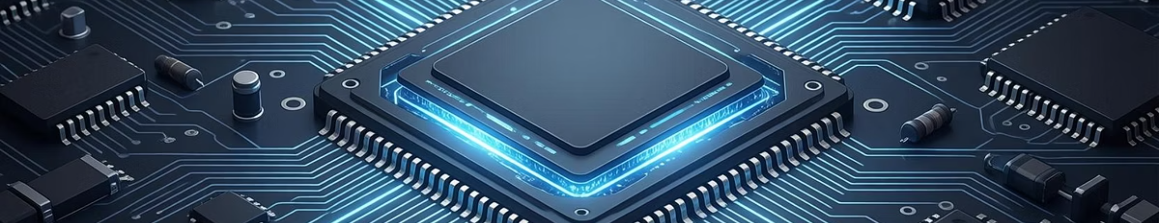

Mastering Low-Level Control
1
2
3
Direct Hardware Interface
Real-time Responsiveness
Resource Optimization
C++ offers direct access to hardware registers and memory, essential for embedded systems and device drivers.
Achieve predictable and deterministic execution crucial for safety-critical and high-frequency applications.
Fine-grained control over memory and CPU cycles allows for highly optimized code in constrained environments.

Slide 4

Modern C++: Beyond Manual Memory
The evolution of Modern C++ has introduced powerful tools to mitigate the risks associated with manual memory management, moving away from explicit new and delete calls.
Smart Pointers, specifically std::unique_ptr and std::shared_ptr, leverage the Resource Acquisition Is Initialization (RAII) idiom to automate resource lifecycle management.
This approach significantly enhances the security and robustness of systems, particularly those requiring continuous operation, such as industrial printing servers, preventing common issues like memory leaks and dangling pointers.

Slide 5

Smart Pointers in Action
std::unique_ptr
1
Ensures exclusive ownership of a dynamically allocated object, preventing multiple owners and enabling efficient resource transfer.
std::shared_ptr
2
Allows multiple ownership of an object, managing its lifetime through reference counting, ideal for shared resources.
RAII Principle
3
Resources are acquired during object construction and automatically released upon destruction, guaranteeing proper cleanup.

Slide 6

Seamless Integration with Foreign Function Interfaces (FFI)
FFI provides a powerful mechanism to integrate existing C++ libraries and codebases into modern environments like Node.js or Rust.
This capability is crucial for leveraging legacy C++ drivers from manufacturers (e.g., Zebra, Epson) without the costly and time-consuming process of complete re-implementation.
By creating "Bindings," developers can seamlessly bridge the gap between different programming language ecosystems, ensuring compatibility and maximizing code reuse.

Slide 7





Bridging C++ and Modern Ecosystems
Existing C++ Libraries
FFI Bindings
Leverage robust and optimized legacy code.
Create interfaces for cross-language communication.
Reusability & Efficiency
Modern Platforms
Avoid re-writing, accelerate development.
Integrate with Node.js, Rust, Python, etc.

Slide 8
Extreme Optimization Techniques
Compile-Time Computations with constexpr
True Multithreading for Parallel Processing
Memory Alignment and Cache Optimization
Utilize modern C++ concurrency features to achieve genuine parallel data processing, maximizing CPU utilization for demanding tasks.
Strategically align data structures in memory to optimize cache usage, leading to faster data access and overall system performance.
Perform calculations at compile time, reducing runtime overhead and improving performance significantly. This is especially vital for embedded systems with limited processing power.

Slide 9

Unlocking Peak Performance
Advanced C++ optimization goes beyond basic code improvements, delving into the intricate mechanics of hardware interaction. Techniques like memory alignment and cache-aware programming are essential.
By understanding how the CPU caches data, developers can design algorithms and data structures that minimize cache misses, leading to substantial speedups in performance-critical sections.
This level of optimization is particularly impactful in embedded systems and high-frequency trading applications where every nanosecond can make a difference.

Slide 10

C++: The Future of High-Performance Systems
Modern C++ provides the tools to build robust, efficient, and compatible systems for today's and tomorrow's challenges.

